Slide 1
Reverse Proxy
https://www.youtube.com/watch?v=ozhe__GdWC8

Slide 2
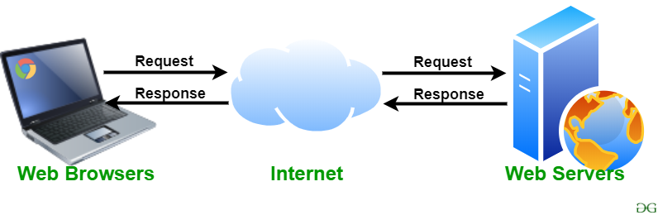
Web Server
Web Servers are computers which deliver the requested web pages. Every web server has an IP Address and a domain name.
To make any system webserver there are many services avaliable

Slide 3
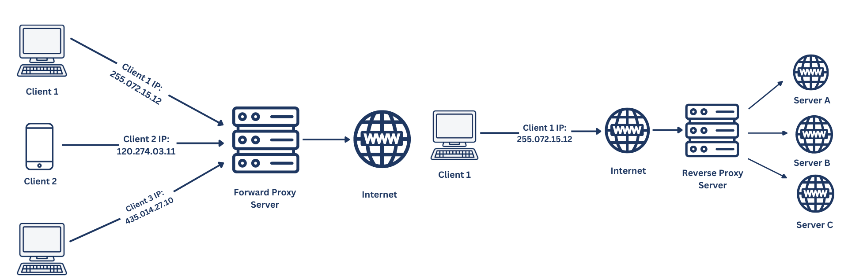
Forward Proxy vs Reverse Proxy
A traditional forward proxy server allows multiple clients to route traffic to an external network. For instance, a business may have a proxy that routes and filters employee traffic to the public Internet. A reverse proxy, on the other hand, routes traffic on behalf of multiple servers.

Slide 4
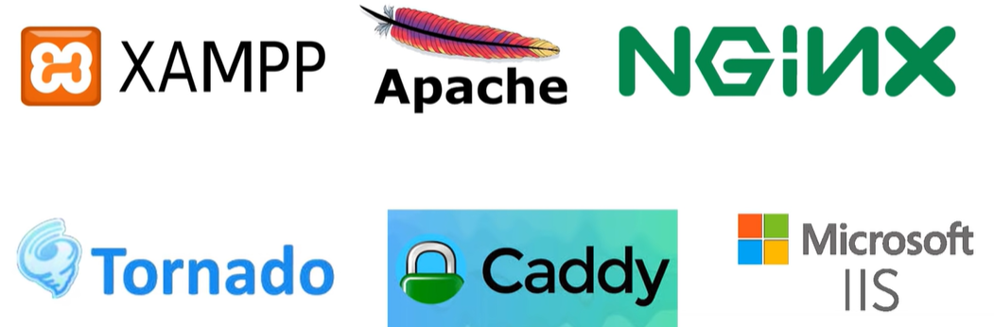
Various Web Servers

